Slide 1

SDM DB Impact Analyzer
Project Sponsor: Girija Sahoo
Green Belt Associate: Sachin Chauhan
Project Mentor: Roopam Chhabra
Master Black Belt Mentor: Thomas Prasad V
Project ID - 304240
February 24th, 2014
TCS Internal

Slide 2
Project Selection
# | Parameters | Considered | Remark
1 | Is there a Customer &/or Internal impact / benefit? |  | Tangible & intangible
2 | Does this project help realize Customer’s business goals? |  | Cost reduction
3 | Do you know the business objective? |  | Customer satisfaction
4 | Is the Sponsor willing to provide resources? |  | Key SME identified by sponsor
5 | Can the project be done in 6~9 months? |  | Rigor to complete the project
6 | Is the project scope within control of the Project Team? |  | Onsite & offshore team collaboration
7 | Can the benefits be quantified in money value? |  | Cost saving in $
8 | Is there a benefit to stakeholders? |  | Customer & delivery team

Slide 3
Project Charter
Business Case (Including High Level Benefit Analysis)
Specific Goal Statement
Database migration from Informix to Oracle was done to improve scalability, maintainability and efficiency of database operations.
Applications (Java and WMB) and Unix utilities pointing to Informix are to be ported from Informix to Oracle database
Identification and Analysis of the code changes required for porting the Applications (Java and WMB) and Unix utilities from Informix to Oracle are to be done for following types of changes:
  Column Name Changes
  Data type Changes.
To reduce the time to do porting of the Applications (Java and WMB) and Unix utilities from Informix to Oracle by 25 % by 31st Oct 2014
In Scope
Java Applications (5 in no.)
Unix Scripts (30 in no.)
WMB Applications (7 in no.)
Out of Scope
Configuration changes.
Specific Problem Statement
On an average it takes around 2.5 hours in all to identify a change and then Unit test it.
1320 places required code changes for porting Application (Java and WMB) and Unix Utilities from Informix to Oracle. This is prone to Manual errors and would require further Reanalysis.
Need to create a DB Impact Analyzer which will help Automate the process to identify the required code changes.

Slide 4
Alignment to Business Big Y
Business Big
Customer Satisfaction
Defect Prevention & Reduction, Defect Free Deliverables
Industry CTQ
y₁
y₂
y₃
Project CTQ: characteristic
Defects, Effort & Cycle Time
y_{A}
y_{B}
y_{C}
Measurable
y
Number of Defects

Slide 5

Project Scope
C
O
P
I
S
C
O
P
I
S
Customer
Output
Process
Input
Supplier
(Use nouns)
Start
(Use verbs)
Stop
(Use nouns)
Unit Testing Result
DB Impact Analyzer
Java Code
Developer
Analysis of the
required changes
for porting
Start Unit Test
case Execution
Is Test Case pass?
Unit Testing
Complete
Yes
No

Slide 6
As-Is Value Stream Map
Value added activity
Non value added activity
Processing Time
.
User/Customer
SDLC
Do Analysis
of required
changes
Do required
changes
Unit
Test
Integrate
660 Hr
396Hr
1980 Hr.
520 Hr.
Users/Customer
Reanalysis
1200 Hr

Slide 7
As Is Process Value Analysis
Process Step | Changes | Hrs. per Change | Time (in Hrs) | Total %
Do Informix to Oracle changes detailed analyses | 1320 | 0.5 | 660 | 13.88
Do the required changes for migration | 1320 | 0.3 | 396 | 8.33
Do Unit Testing of the code changes | 1320 | 1.5 | 1980 | 41.63
Reanalysis due to failure in Unit testing | 600 | 2 | 1200 | 25.23
Integration Specific changes (ie. WMB changes) | 10 | 52 | 520 | 10.93
Over all Effort |  |  | 4756 | 100
Value Added Time (Hrs) | 60.89%
Non Value Added Time (Hrs) | 39.11%

Slide 8
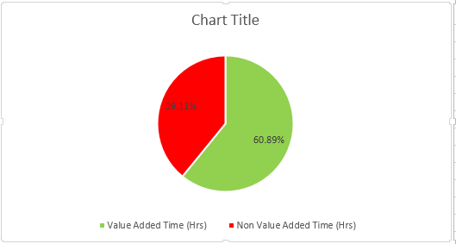
As Is Categorization of Value Added vs Non Value added time
Overall estimated effort before PI was 4756 hrs

Slide 9
Lean Analysis
Operation | Problem | Proposed Action | Results | Waste Reduction
Porting of Application and Unix Scripts | Time required to analyse changes required for porting from Informix to Oracle is high and prone to Manual Error. | There is a need to develop a utility to identify changes required for porting. This will automate the process and reduce the effort. | Reduced the overall effort in analyzing the required changes and reducing the effort for unit testing | Effort and Analysis Time
Before Kaizen
Developer had to spend huge time in analyzing the code for required changes and has to rework after Unit
Testing.
After Kaizen
With the introduction of Impact Analyzer, the developer can quickly identify changes and can reduce the time of rework.

Slide 10
To-Be Value Stream Map
Value added activity
Reduced As Is Non value added activity
.
User/Customer
SDLC
Do Analysis
of required
changes
Do required
changes
Unit
Test
Integrate
330 Hr
396Hr
1980 Hr.
520 Hr.
Users/Customer
Reanalysis
290Hr

Slide 11
To Be Process Value Analysis
Process Step | Changes | Hrs. per Change | Time (in Hrs) | Total %
Do Informix to Oracle changes detailed analysis | 1320 | 0.25 | 330 | 9.39
Do the required changes for migration | 1320 | 0.3 | 396 | 11.26
Do Unit Testing of the code changes | 1320 | 1.5 | 1980 | 56.31
Reanalysis due to failure in Unit testing | 145 | 2 | 290 | 8.25
Integration Specific changes (ie. WMB changes) | 10 | 52 | 520 | 14.79
Over all Effort |  |  | 3516 | 100
Value Added Time (Hrs) | 82.37%
Reduced Non Value Added Time (Hrs) | 17.63%

Slide 12
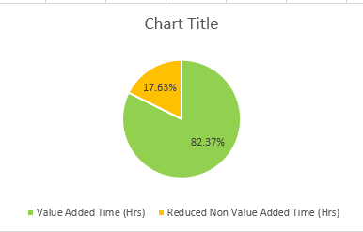
To Be Categorization of Value Added vs Non Value added time
Effort to implement the project after PI 3516 hrs

Slide 13
Effort Saving
Effort Savings
Effort | Hrs
Overall As Is Effort | 4756
Overall To Be Effort | 3516
Effort in Implementing - executing DB Impact Analyzer (hrs) | 40
Effort Saving | 1280
Overall Reduced Effort | 26.91%

Slide 14

Dollar Saving
Cost | CAD
Bill Rate per hr | 27
Overall As Is Cost | 128412
To Be Cost after PI | 94932
Cost of Implementing and Executing DB Impact Analyzer | 1080
Dollar Savings | 34560

Slide 15

Achievement
Achieved 26.91% effort reduction against target of 25%

Slide 16

Thank You

